Slide 1
Date Object
Date Object | Date Methods
Notes:
Welcome to our lecture on Date Objects in JavaScript. In this lecture we will go through date objects and date methods. Let’s start our lecture.

Slide 2

Introduction to Date Object
Date object represents time in milliseconds since January 1, 1970, UTC.
Uses UTC/GMT as the time standard.
Created with new operator and a constructor function.
Notes:
Today, we’re introducing the JavaScript Date object. This object allows us to work with dates and times, representing time in milliseconds since January 1, 1970, UTC. It uses the UTC GMT standard to keep things consistent across different time zones. To create a Date object, we use the new keyword followed by a constructor function. This lets us easily manage and manipulate dates in our programs.

Slide 3
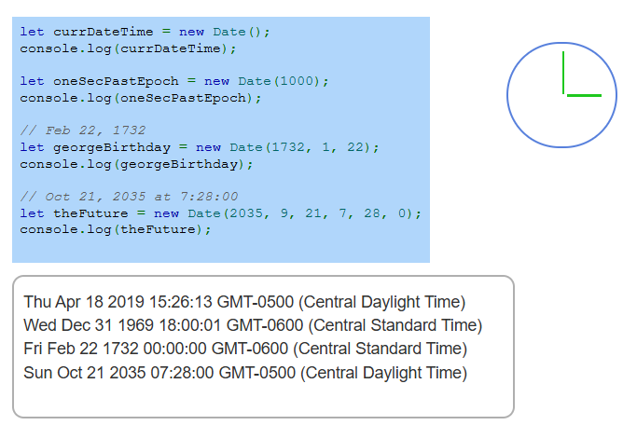
Example
Notes:
Now, let’s look at some examples of the JavaScript Date object in action. First, we create a new Date object representing the current date and time. Then, we create a Date object using milliseconds since the epoch. We can also specify exact dates, like George Washington's birthday in 1732. Lastly, we define a future date with specific time values. These examples show how flexible the Date object is for handling time data.

Slide 4
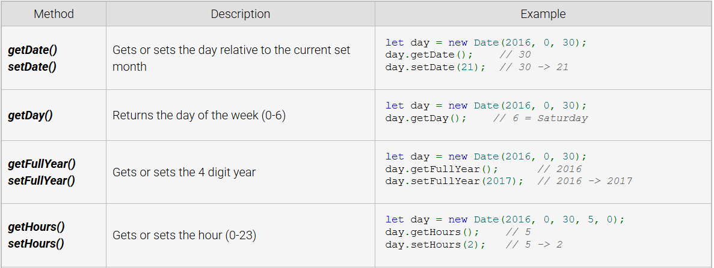
Date methods
Notes:
Now, let’s explore some important Date methods in JavaScript. The getDate and setDate methods retrieve or modify the day of the month. The getDay method returns the weekday as a number from zero to six. The getFullYear and setFullYear methods manage the four-digit year. Lastly, the getHours and setHours methods handle the hour of the day. These methods allow precise control over date and time values.

Slide 5
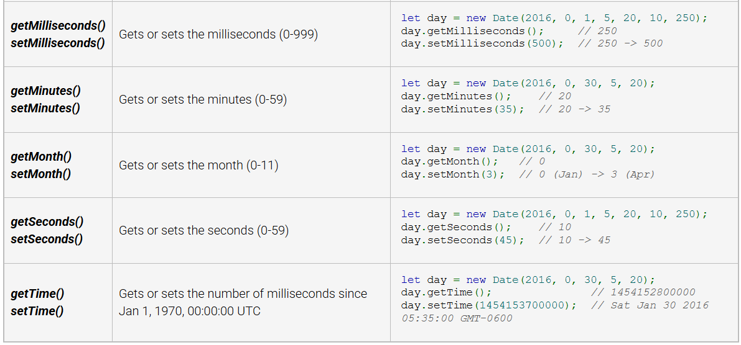
Date methods
Notes:
Now, let’s look at more JavaScript Date methods. The get Milli seconds and set Milli seconds methods retrieve or modify milliseconds. The get Minutes and set Minutes methods handle minute values. The get Month and set Month methods manage months from zero to eleven. The get Seconds and set Seconds methods control seconds. Finally, get Time and set Time work with time in milliseconds since January 1, 1970. These methods provide precise time handling.

